Slide 1
GRYVEYARDS
GAME MUSIC REFERENCES

Slide 2
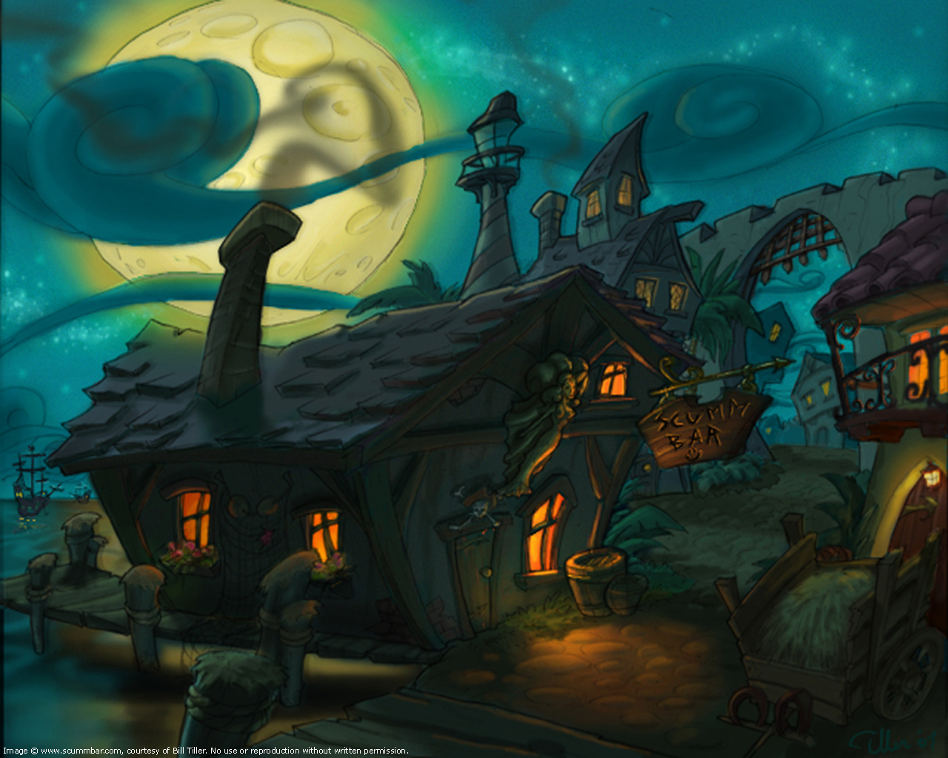
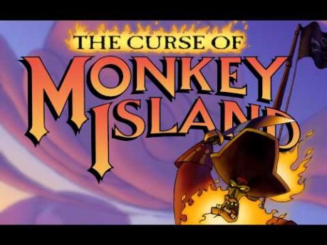
REFERENCE The Curse of Monkey Island
Things that might be useful towards the project:
Harpsichord.
Plucked cello & bass.
Vocal background drone.
Glockenspiel.
Sad, dark patterns.

Slide 3
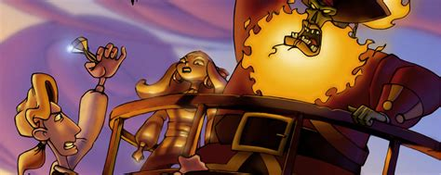
REFERENCE The Curse of Monkey Island
Things that might be useful towards the project:
Bassoon.
Bass Clarinet
Rhythmic music.
Melody driven.

Slide 4
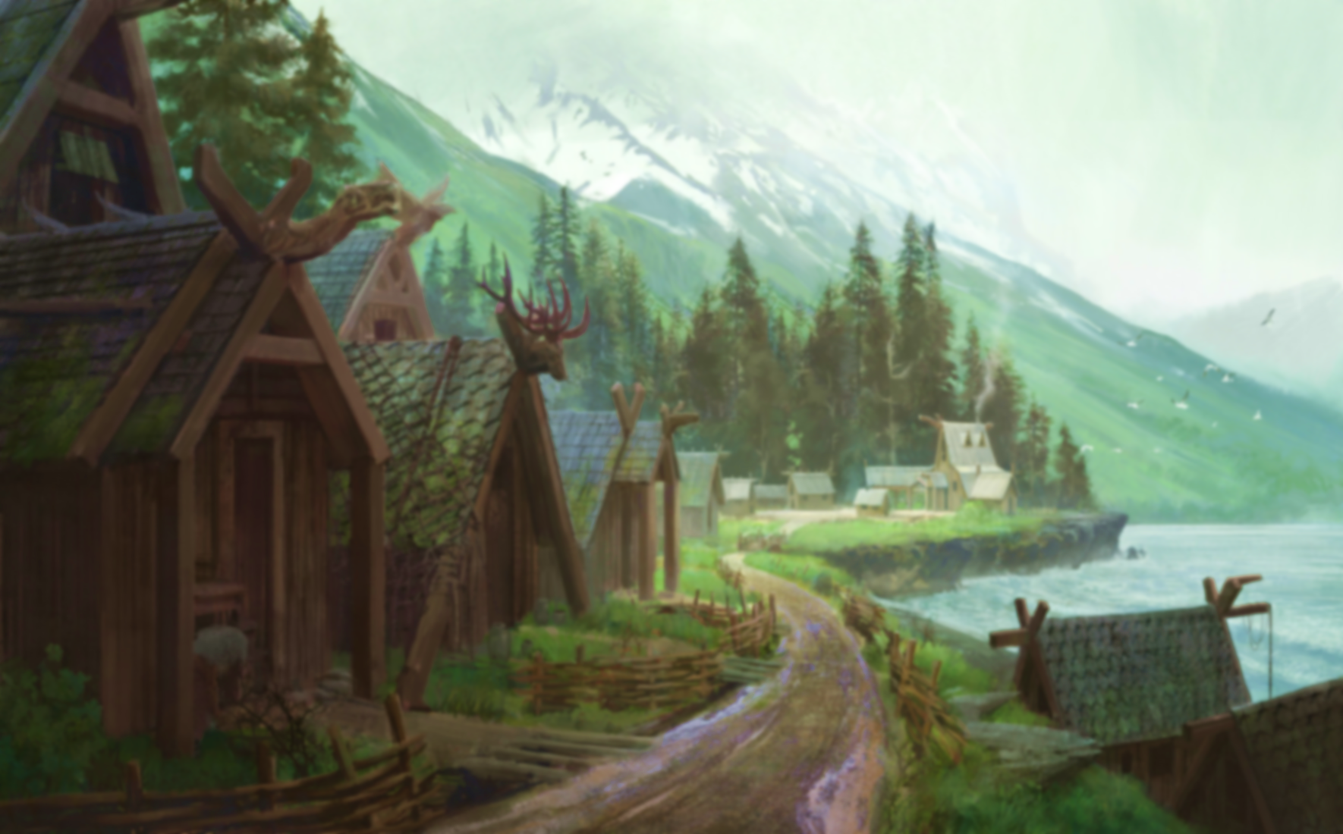
GAME PITCH

